Slide 1

Advanced Corporate Finance (LL4554V/LL5554V/LLJ5554V/LL6554V) 2. Introduction and present values
LL4554V
Kenneth Khoo
kenneth.khoo@nus.edu.sg

Slide 2

Introduction and present values
Introduction to Corporate Finance
Corporate Investment and Financing Decisions.
The Financial Goal of the Corporation.

Slide 3
Introduction and present values
Present Values
Calculating Future and Present Values.
Valuing Perpetuities and Annuities.
How Interest Is Paid and Quoted.

Slide 4

Corporate Investment and Financing Decisions
To do business, a company requires inputs which are then used to produce goods and services. These inputs are known by financiers as “real assets”, as they have intrinsic value (Q: what is “intrinsic value”?) in and of themselves, rather than having value only from what they can buy. Two categories of real assets:
Tangible Assets: Physical assets such as oil fields, factories, and machines (things you can touch)
Intangible Assets: No physical substance, such as patents, brands, and corporate culture.
Real assets must be bought externally or developed internally; either way, they cost money. Companies pay for their real assets by selling claims on them and the cash flows they will generate. These claims are termed “financial assets”.
E.g., issuance of shares/corporate bonds. Tradeable financial assets are known as securities.
This Photo by Unknown Author is licensed under CC BY-SA
Notes:
Real assets have value because they directly provide goods/services or contribute to production

Slide 5

Corporate Investment and Financing Decisions
The defining feature common to all assets that they generate benefits to the owner in the future.
Corporate finance is the study of how to value assets to see if they are worth the cost (The Investment Decision) and how to raise the funds to pay for them (The Financing Decision).
The investment decision typically involves the purchase of real assets.
E.g., whether the coy should build a new factory
The financing decision typically involves the sale of financial assets.
E.g., whether the coy should issue shares/bonds.

Slide 6
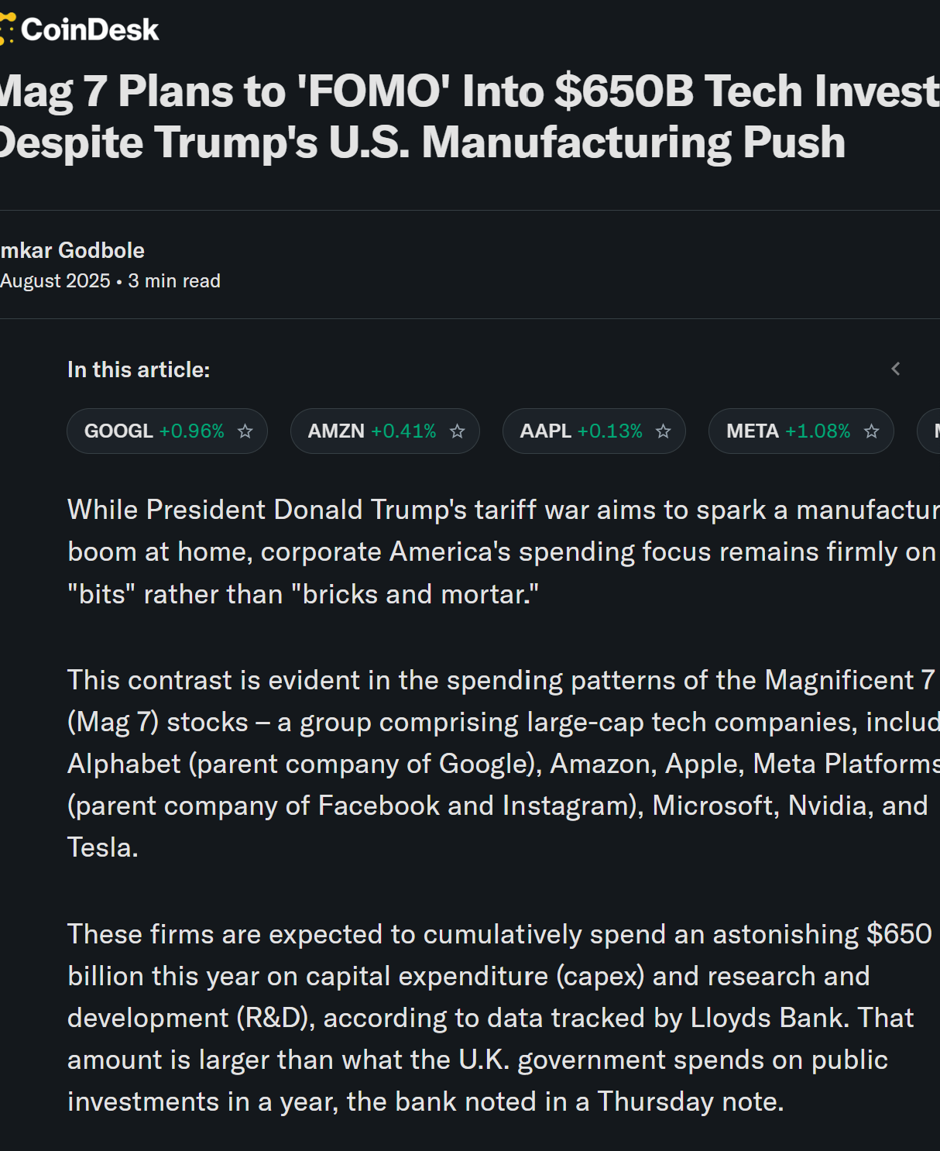
Corporate Investment and Financing Decisions
The investment decision involves decisions whether to invest in tangible or intangible assets.
Decisions to invest in tangible assets (e.g., to build a new data centre) are known as capital expenditure, or CAPEX decisions.
Decisions to invest in intangible assets include R&D, advertising, and marketing decisions.
Brealy et al: “Consumer goods companies, such as Unilever or Procter & Gamble, invest huge sums in advertising and marketing their products. These outlays are investments because they build know-how, brand recognition, and reputation for the long run.”

Slide 7
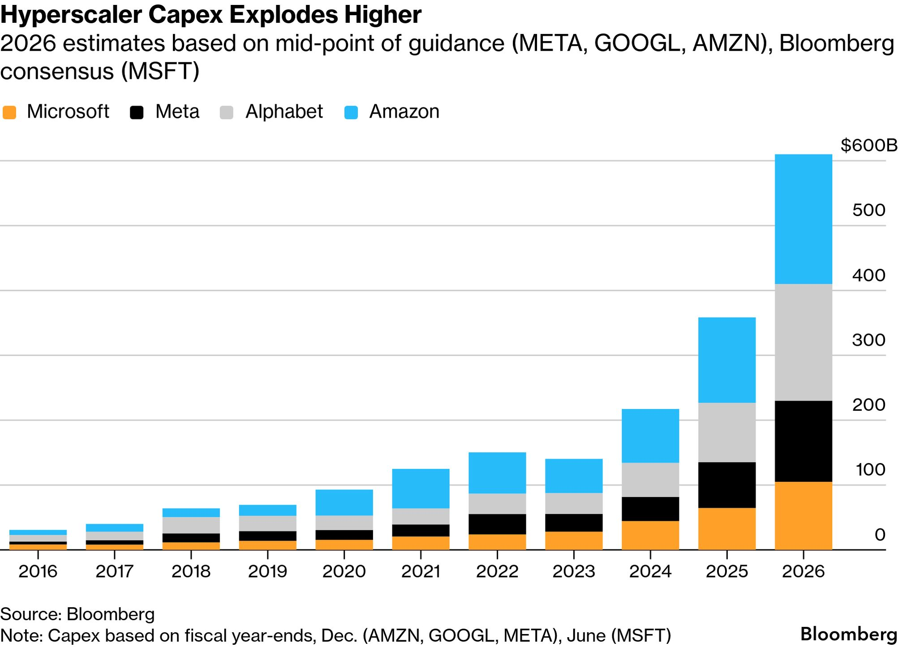
Corporate Investment and Financing Decisions

Slide 8
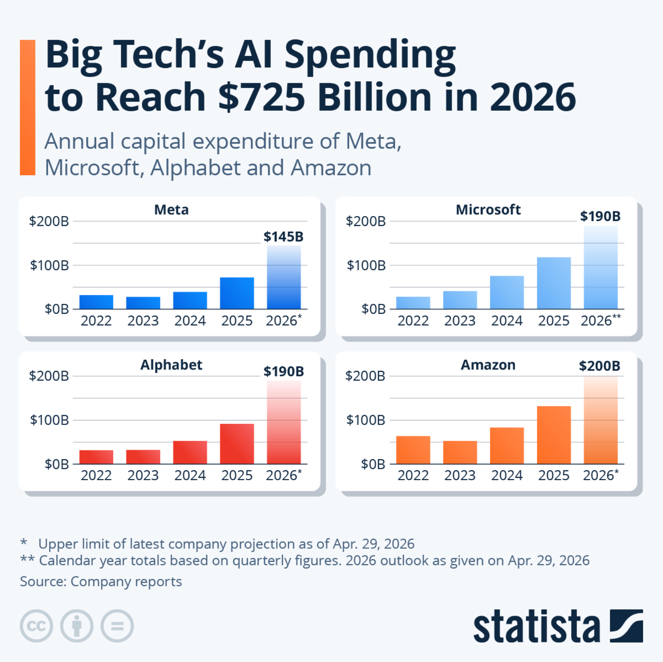
Corporate Investment and Financing Decisions

Slide 9
Corporate Investment and Financing Decisions
The financing decision largely involves decisions as to whether to raise funding via debt or equity. The choice between debt and equity financing is called the capital structure decision:
Debt: Lenders provide debt. In return, they receive an agreed rate of interest and are repaid the debt at maturity, the end of the loan.
Equity: Shareholders provide equity. In return, they [may] receive a fraction of any future dividends the company chooses to pay out.
The financing choices available to large companies seem almost endless. Suppose the firm chooses debt. Should it borrow from a bank or issue tradeable bonds? Should it borrow for 1 year or 20 years? If it borrows for 20 years, should it reserve the right to pay off the debt early? Suppose the firm chooses equity. Should it issue dividends to the shareholders, or should it reinvest profits into real assets via retained earnings?
C.f. focus in law (e.g., Luh Luh’s course), where we are concerned about the legal regime that constrains financing decisions.

Slide 10
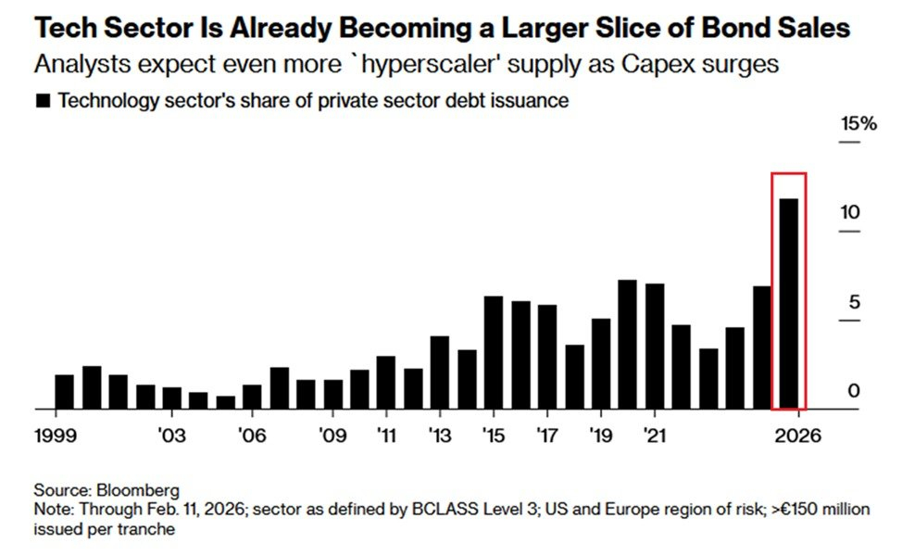
Corporate Investment and Financing Decisions

Slide 11
Corporate Investment and Financing Decisions
Company | Recent Investment Decisions | Recent Financing Decisions
Intel (US) | Invests $7 billion in expanding semiconductor plant in Chandler, Arizona. | Borrows $600 million from Chandler Industrial Development Authority.
Amazon (US) | Acquires self-driving start-up, Zoox, for over $1.2 billion | Reinvests $33 billion that it generates from operations
Tesla (US) | Announces construction of new plant to build the electric Cybertruck | Announces plans to sell $2 billion of shares
Shell (UK) | Starts production at a deep water development in the Gulf of Mexico | Cuts dividend to preserve cash
B Y D (China) | Increases production capacity to meet fast-growing demand for its electric cars | Reduces total debt from RMB 33.7 billion to RMB 18.5 billion

Slide 12
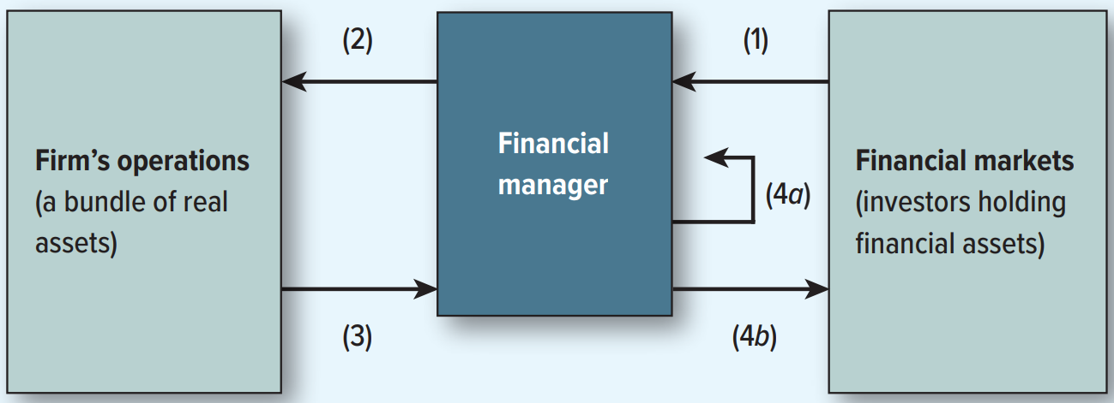
Corporate Investment and Financing Decisions
Cash raised by selling financial assets to investors.
Cash invested in the firm’s operations and used to purchase real assets.
Cash generated by the firm’s operations.
(a) Cash reinvested (b) Cash returned to investors.
Q: Who is the “financial manager” here?

Slide 13
The Financial Goal of the Corporation
As the ostensible “owners” of the firm (at least from a Finance POV), shareholders want three things.
To maximize current wealth.
To transform wealth into most desirable time pattern of consumption (deciding whether to consume their wealth now or to invest (“save”) it to spend later).
To manage risk characteristics of chosen consumption plan according their risk appetite.

Slide 14
The Financial Goal of the Corporation
How can the financial manager help the shareholder?
Maximize Wealth (Fisher Separation Theorem)
Brealey et al: “Economists have proved this value-maximization result with great rigor and generality. It’s known as the Fisher separation theorem, because it shows that a financial manager's investment decisions can be separated from shareholder preferences.”
Intuition: Shareholders don’t need the financial manager’s help to achieve the best time pattern of consumption.
They can do that on their own, provided they have free access to competitive financial markets, by deciding when to buy/sell their shares.
They can also choose the risk characteristics of their consumption plan by investing in more or less risky securities.
Because the market allows for “DIY” consumption patterns, the manager’s only job is to provide the largest possible “pool of money” for the shareholders to work with.

Slide 15
The Financial Goal of the Corporation
Note that wealth maximization is not the same as profit maximization, which doesn’t have a well-defined financial objective.
Which years’ profits? A company may be able to increase current profits by cutting R&D, but that may result in lower profits in the future. How do we know whether “profits” are maximized if some years’ profits rise and others fall?
What about risk? If a project will increase the company's profits but also make it riskier, it’s not clear that the manager should take it. Risk is a crucial factor that affects shareholder wealth.
While profits are not well defined (as an objective), shareholder wealth is.
This requires a framework of valuation; of which half of this course dedicates itself to.

Slide 16
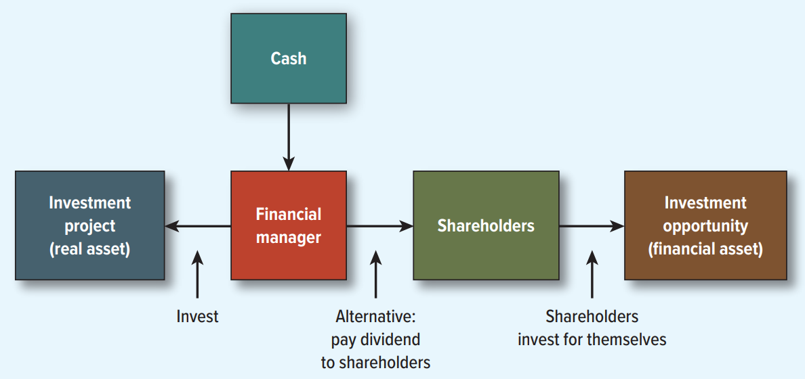
The Financial Goal of the Corporation
Arrows represent possible cash flows or transfers.

Slide 17
The Financial Goal of the Corporation
Agency problem: In the context of corporate finance, the agency problem refers to a fundamental conflict of interest where managers, acting as agents for stockholders, are tempted to prioritize their own personal interests rather than maximizing the overall value of the firm.
Agency costs: These costs represent the tangible value lost from agency problems occurring, alongside the actual costs incurred by the firm to mitigate such behaviors—for example, through monitoring or specialized compensation structures.
We will not make agency problems or agency costs a primary focus of this course. From a legal standpoint, the doctrine of directors' duties in corporate law already provides a framework to address many of these issues.
Comprehensive and advanced methods for analyzing and dealing with agency problems are more properly situated within a specialized course on corporate governance. The bulk of this interdisciplinary analysis is therefore taught in my other elective, “Corporate Law and Economics”
Our focus remains on the financial mechanics of valuation and decision-making; we assume for the purposes of our models that managers are acting in accordance with the wealth-maximization principles established by the Fisher Separation Theorem.

Slide 18
Calculating Future and Present Values.
Future Value.
Amount to which an investment will grow after earning interest.
Compound Interest.
Interest earned on wealth that grows at a compound rate.
Present Value.
Value today of a future cash flow.

Slide 19
Calculating Future and Present Values.
Future Value of $100 = FV, where in this context, $t$ is the measured in years and $r$ is the annualized rate of return (time value of money)
Example:
What is the future value of $100 if interest is compounded annually at a rate of 7% for 2 years?

Slide 20
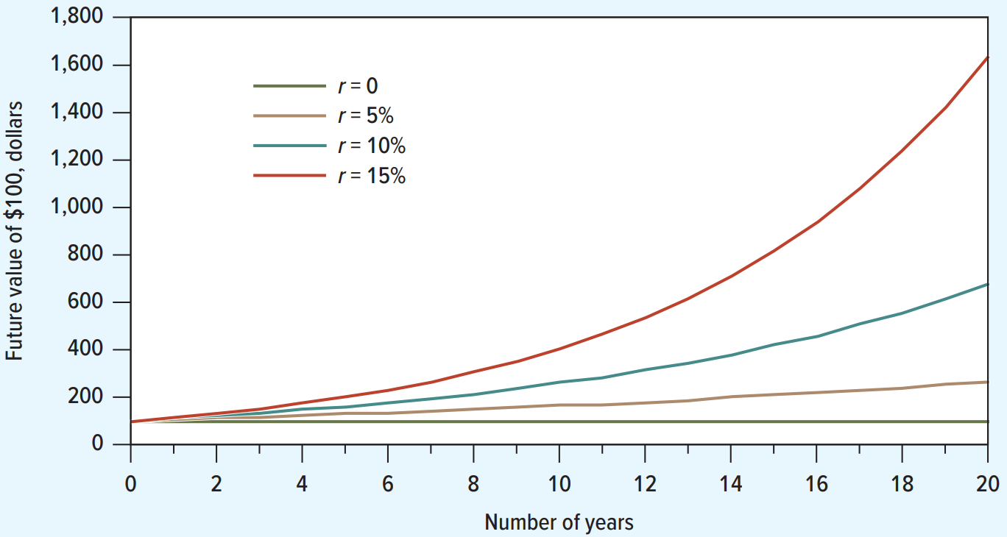
Calculating Future and Present Values.

Slide 21
Calculating Future and Present Values.
Discount factor = DF = PV of $1. Discount factors are termed as such because a dollar today is worth less in future.
Discount factors can be used to compute the present value of any cash flow.
Present value = PV

Slide 22
Calculating Future and Present Values.
The P V formula has many applications. Given any variables in the equation, you can solve for the remaining variable. Also, you can reverse the prior example regarding future values.

Slide 23
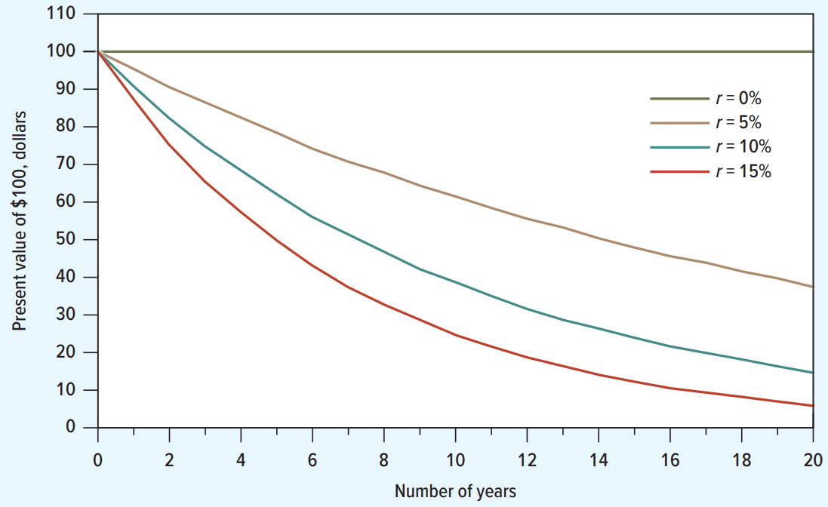
Calculating Future and Present Values.

Slide 24
Calculating Future and Present Values.
Example regarding whether coy should take on project (in textbook).
Step 1: Forecast cash flows.
Step 2: Estimate opportunity cost of capital.
If equally risky investments in the capital market offer a return of 7%, then:
Cost of capital = r = 7%

Slide 25
Calculating Future and Present Values.
Step 3: Discount future cash flows.
Step 4: Go ahead if P V of payoff exceeds investment.

Slide 26
Calculating Future and Present Values.
Net Present Values (NPV), where PV of $C_{1}$ are the returns from the project and $C_{0}$ relates to the initial required investment:

Slide 27
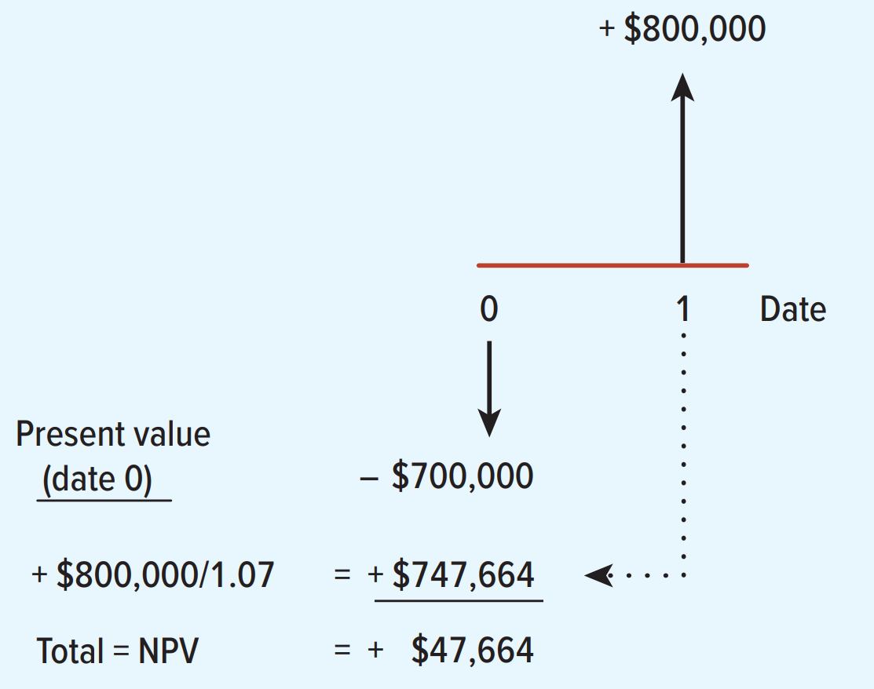
Calculating Future and Present Values.

Slide 28
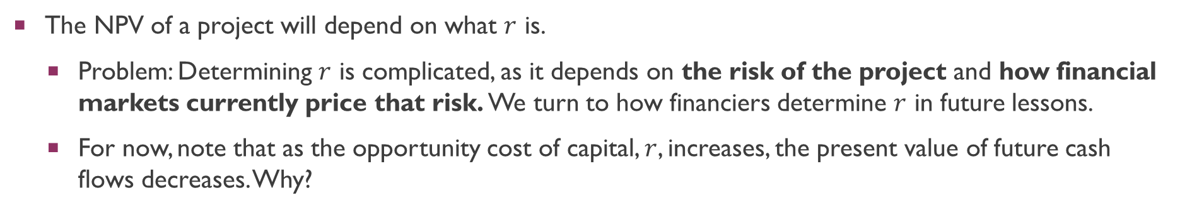
Calculating Future and Present Values.
The NPV of a project will depend on what $r$ is.
Problem: Determining $r$ is complicated, as it depends on the risk of the project and how financial markets currently price that risk. We turn to how financiers determine $r$ in future lessons.
For now, note that as the opportunity cost of capital, $r$, increases, the present value of future cash flows decreases. Why?

Slide 29
Calculating Future and Present Values.
The NPV of a project will depend on what $r$ is.
Problem: Determining $r$ is complicated, as it depends on the risk of the project and how financial markets currently price that risk. We turn to how financiers determine $r$ in future lessons.
For now, note that as the opportunity cost of capital, $r$, increases, the present value of future cash flows decreases. Why?

Slide 30
Calculating Future and Present Values.
A rule of thumb for the CFO: Always accept investments which have positive net present value.
Example:
Use the original example. Should we accept the project given a 10% expected return?

Slide 31
Calculating Future and Present Values.
Alternative rule of thumb for the CFO: Accept investments that offer rates of return in excess of their opportunity cost of capital.
Example:
In the project listed below, the foregone investment opportunity is 12%. Should we do the project?

Slide 32
Calculating Future and Present Values.
Thus far, we have been working with a stylized model where [discrete] cash flows are realized (i.e., paid out) in 1 year or 2 years. What about settings where an investment has payoffs across multiple periods?
For multiple periods, we have the discounted cash flow (DCF) formula:
As we will learn next week, this is the central pricing formula for all fixed income instruments like bonds.

Slide 33
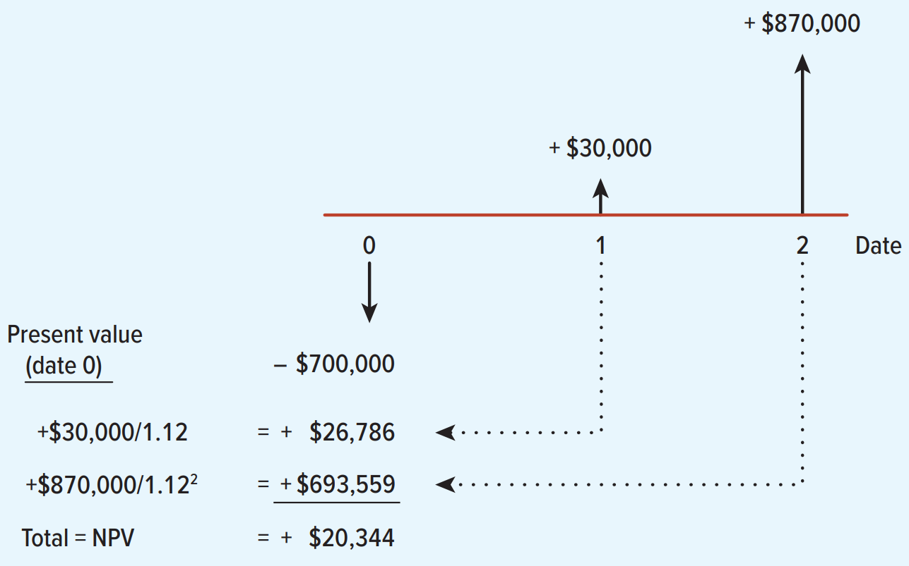
Calculating Future and Present Values.

Slide 34
Valuing Perpetuities and Annuities.
Sometimes there are shortcuts that make it very easy to calculate the present value of an asset that pays off in different periods.
These tools allow us to cut through the calculations quickly.
Shortcuts can be formally derived from the DCF formula expounded above.

Slide 35
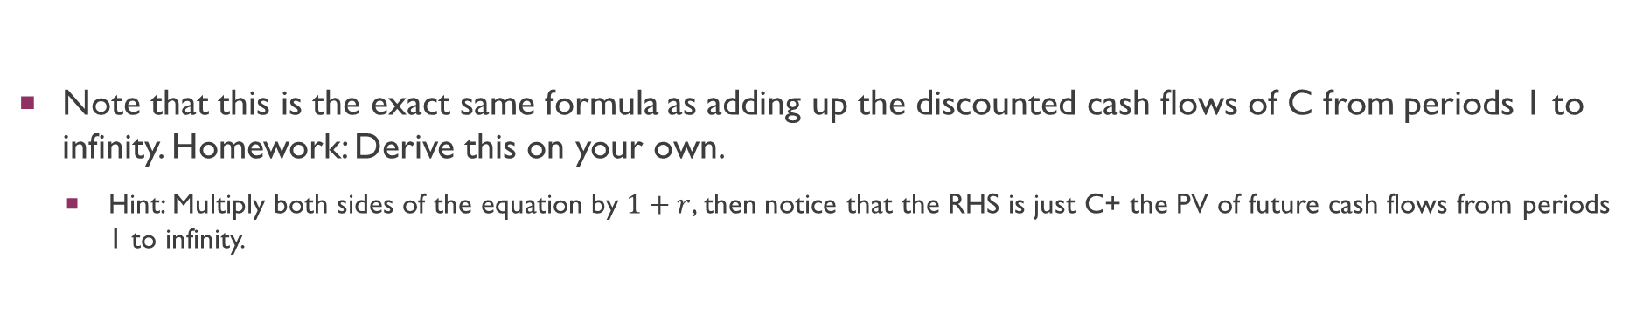
Valuing Perpetuities and Annuities.
We first turn to the valuation formulation of a Perpetuity: Financial instrument in which a cash flow is theoretically received forever.
Assume each cash flow is received at the end of the period. Then:
Note that this is the exact same formula as adding up the discounted cash flows of C from periods 1 to infinity. Homework: Derive this on your own.
Hint: Multiply both sides of the equation by $1+r$, then notice that the RHS is just C+ the PV of future cash flows from periods 1 to infinity.

Slide 36
Valuing Perpetuities and Annuities.
Example:
What is the present value of $1 billion every year, for all eternity, if you estimate the perpetual discount rate to be 10%?
Example:
What if the investment does not start making money for 3 years (first payment received at the end of the third year)? This is just the discount factor for 3 years multiplied by the value of the perpetuity right now.

Slide 37

Valuing Perpetuities and Annuities.
Next, we turn to the valuation formulation of an Annuity: Financial instrument which pays a fixed sum each year for a specified number of years.
Assume each cash flow is received at the end of the period. Then:
Note that this is the exact same formula as adding up the discounted cash flows of C from periods 1 to t. Homework: Derive this on your own.
Hint: Multiply both sides of the equation by $1/1+r$, then subtract the second equation from the first.

Slide 38
Valuing Perpetuities and Annuities.
P V Annuity Factor (PVAF): The present value of $1 a year for each of t years.

Slide 39
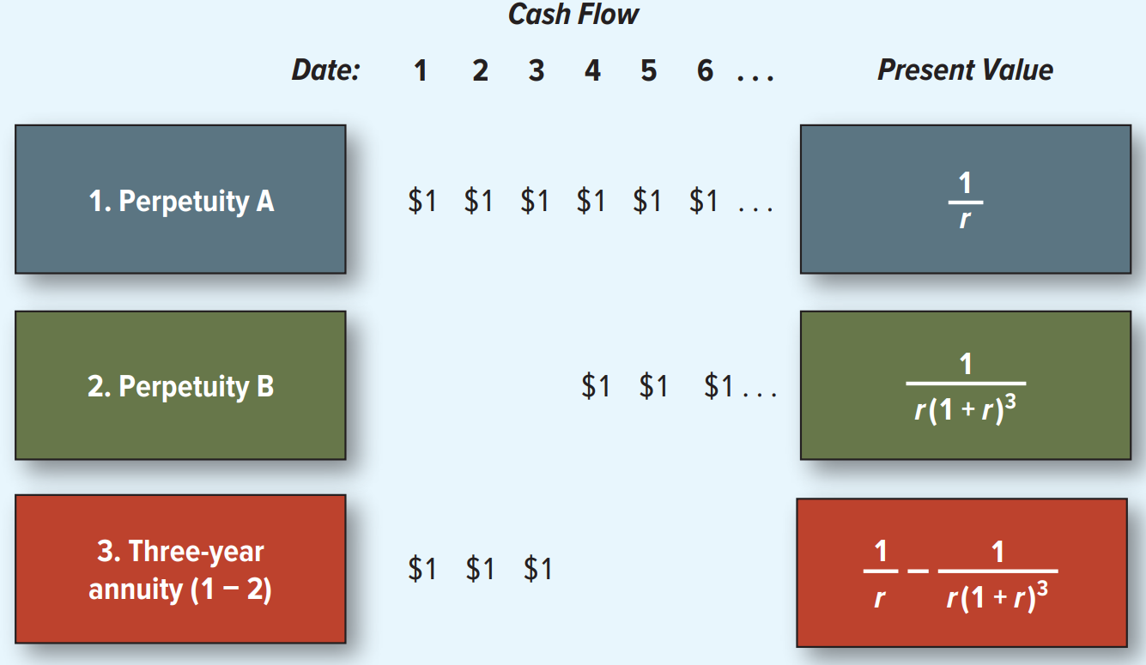
Valuing Perpetuities and Annuities.

Slide 40
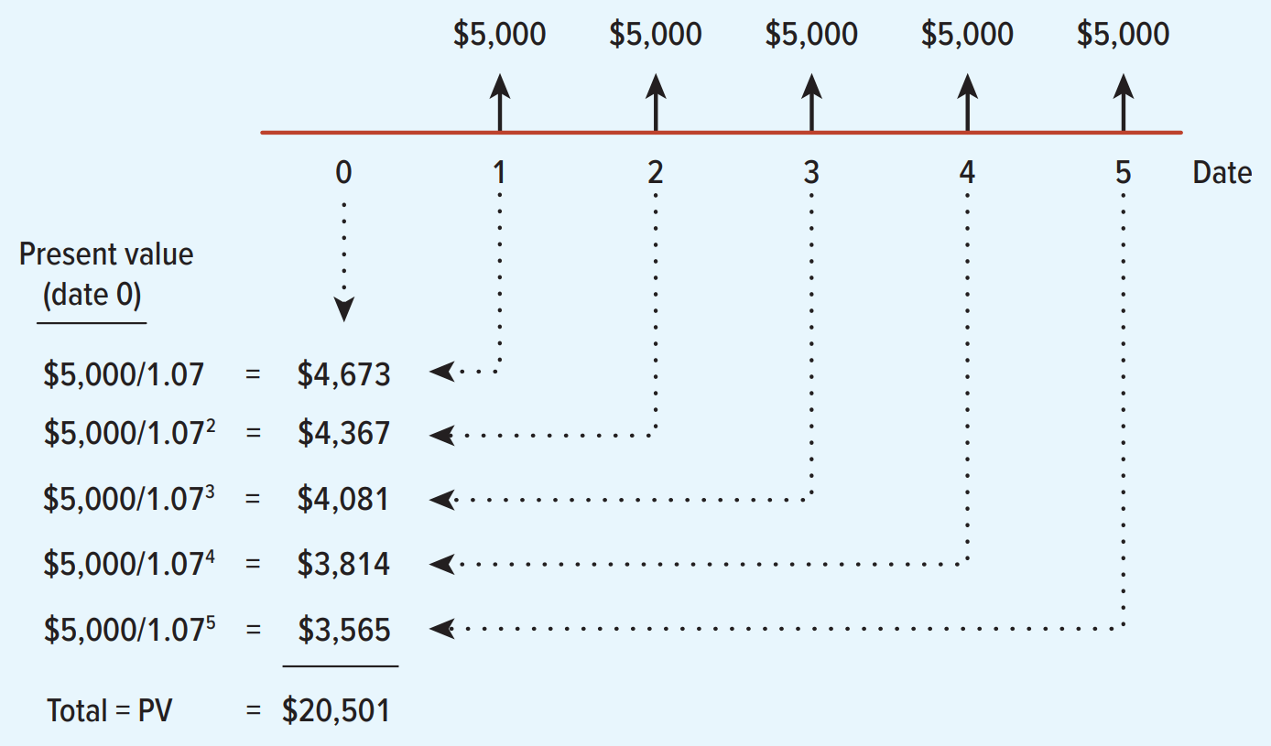
Valuing Perpetuities and Annuities.

Slide 41
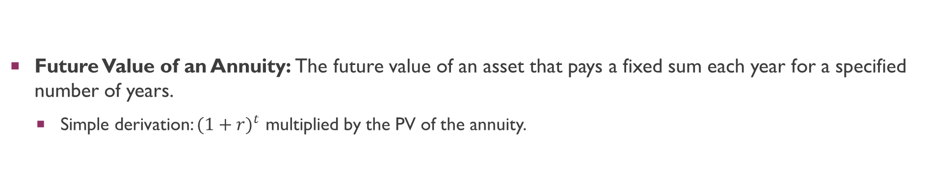
Valuing Perpetuities and Annuities.
Future Value of an Annuity: The future value of an asset that pays a fixed sum each year for a specified number of years.
Simple derivation: ${(1+r)}^{t}$ multiplied by the PV of the annuity.
Example: What is the future value of $20,000 paid at the end of each of the following 5 years, assuming your investment returns 8% per year?

Slide 42
How interest is paid and quoted
We have assumed that cash flows occur only at the end of each year. This is sometimes the case. For example, in France and Germany, the government pays interest on its bonds annually. However, in the U.S. and UK, government bonds pay interest semiannually.
Thus, if a U.S. government bond promises to pay interest of 10% a year, the investor in practice receives interest of 5% every six months.
Annual Percentage Rate: Interest rate that is annualized using simple interest.
This is the 10% figure quoted above.
Effective Annual Interest Rate: Interest rate that is annualized using compound interest.
Because interest is paid every 6 months, interim interest payments can be reinvested to earn additional returns before the end of the year, a semi-annual rate (e.g., 5% every six months) results in a higher effective annual yield (e.g., 10.25%) than a simple annual rate. How do we get this rate?

Slide 43
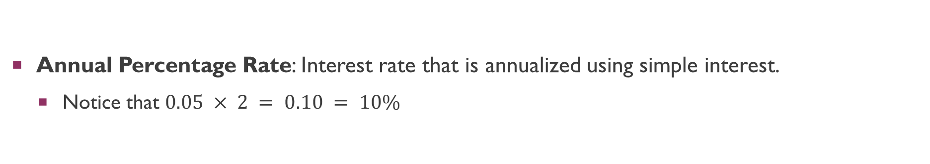
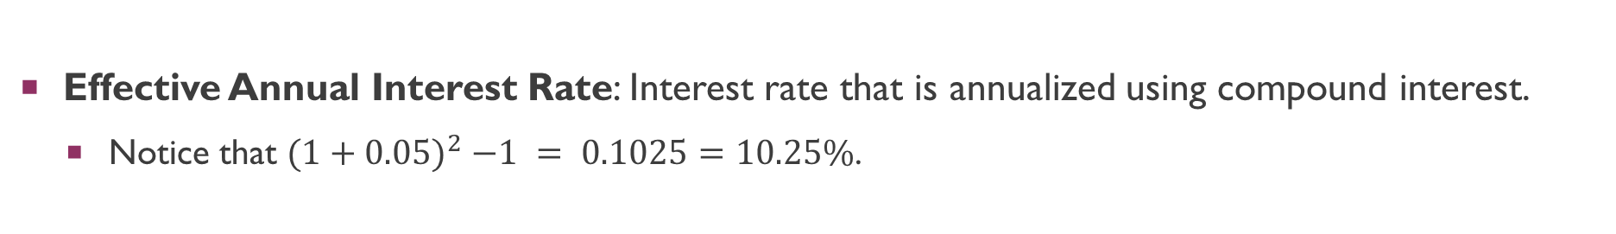
How interest is paid and quoted
Annual Percentage Rate: Interest rate that is annualized using simple interest.
Notice that $0.05 × 2 = 0.10 = 10\%$
Effective Annual Interest Rate: Interest rate that is annualized using compound interest.
Notice that ${(1+0.05)}^{2} −1 = 0.1025=10.25\%$.

Slide 44
Q&A
See you guys on Thurs.

